Slide 1
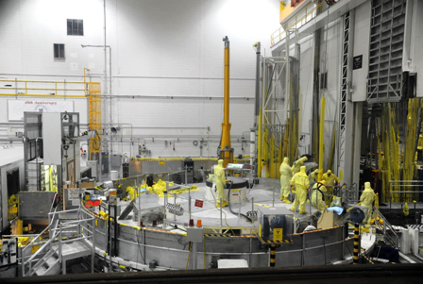
P1. Basic Risk Concepts and Techniques. Overview of the main terms and concepts of the probabilistic safety assessment (PSA)
Presented by: G.Tokmachev, PhD
Atomenergoproekt, Moscow

Slide 2
Background
PSA studies in Atomenergoproekt – since 1988
PSA studies performed for operating plants –Balakovo and Novovoronezh NPPs, Kalinin (fires), Smolensk (fires) in Russia, Kozloduy NPP in Bulgaria
PSA studies performed for plants in design - Rostov, Novovoronezh-2 NPPs, Kursk-2, Smolensk-2 in Russia, Bushehr plant in Iran, Kudankulam NPP in India, Belene NPP in Bulgaria and Akkuyu NPP in Turkey
Many Regulatory reviews and international ones such as IAEA IPSART missions

Slide 3
What Do We Mean by Risk?
The notion of risk is widely used in everyday life
Colloquially, risk is associated with danger, hazard, exposure-to-death, injury, loss, or some other negative consequences:
  Risk implies a potential for harm
  If the danger is actually realized, then it is no longer risk but actual death, injury, loss or other harmful consequence
Risk is inescapable - it is inseparably associated with human existence
Notes:
3
The notion of risk is widely used in our everyday life.
There are many words associated with the notion of risk. Colloquially, risk is associated with danger, hazard, peril, exposure-to-death, injury, loss, or some other negative consequences.
It is important to understand that when we talk about risk we imply an unrealised potential for harm; if the danger is actually realized, then it is no longer risk but actual death, injury, loss or other harmful consequence.

Slide 4
Hazard Versus Risk
A hazard is a potential condition that causes:
  Injury or death to people
  Loss of or damage to equipment, property, etc.
Hazard is a one-dimensional quantity characterized by magnitude, or severity
Risk is characterized by two quantities:
  1) Magnitude (or severity) of the adverse consequence(s) that can potentially result from the given activity, and
  2) Probability of occurrence of the given adverse consequence(s)

Slide 5
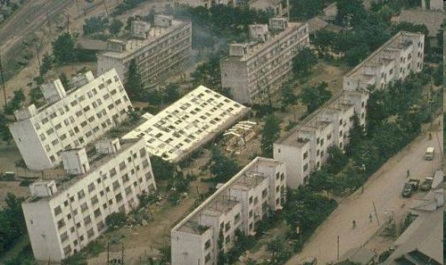
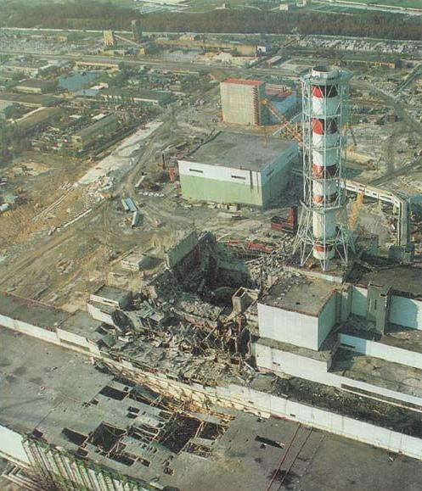
Sources of Risk
Risk can result from natural causes like illness or from natural disaster like earthquakes, floods, tsunamis volcanic eruptions, hurricanes,etc.
Risk can also result from the side effect of human’s technological achievement
Legislation has the responsibility to protect human and property from the harm associated with technical installations and regulate the associated risk

Slide 6


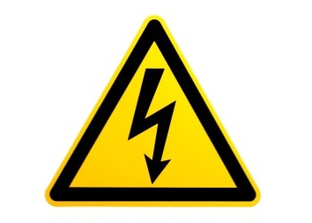

General Concept of Risk
. . .
Other sources of risk to human’s life and health
Notes:
6
There are many sources of risk to human’s life and health:
Some of them are dealing with personal everyday activities like driving a car or using electrical devices;
Some of them can be caused by technological achievements that provide benefits, but at the same time become potential sources of hazard like chemical plants, nuclear power plants, and other industrial installations;
There are also natural phenomena that may cause harm to people, like an earthquake, flood, meteorite strike, and many other.

Slide 7
IAEA Risk Definition #2
For particular consequence mathematical mean (expectation value) of risk can be calculated as the product of the event probability (or frequency with which the event occurs) and the event consequences
Risk = Pi x Ci => Mean frequency of undesirable consequences
RISK
Detriment
Time unit
FREQUENCY
Event
Time unit
UNDESIRED
CONSEQUENCES
Detriment
Event
=
x

Slide 8
Example of risk assessment
Let us consider an example with aircraft crash and calculate risk to be involved in the accident for man having performed 10 Trips a year:
Risk
for man be involved in an aircraft crash
10⁻⁵
aircraft crash
per year
FREQUENCY
10
flights
a year
Undesirable
consequence
10⁻⁶
Aircraft accident
flight
=
x

Slide 9
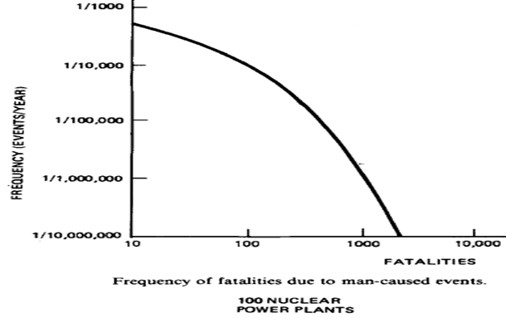
Risk curve
  R (fat>100 ) ≅ 1.E-4 (1/y)
  R (fat>600) ≅ 1.E-5 (1/y)
  R (fat>1000) ≅ 1.E-6 (1/y)

Slide 10
Quantitative Risk Assessment
What can go wrong?
  The answer requires technical knowledge of the possible causes of the detrimental outcomes of a given activity
    Logic tools like Master Logic Diagrams (MLD) or Failure Modes and Effects Analyses (FMEA) have been successfully used
How likely is it?
  The answer is obtained by using Boolean logic methods for model development and by probabilistic or statistical methods for the quantification portion of the model analysis
What are the consequences?
  The answers are obtained by developing and quantifying accident scenarios, which are chains of events that link the initiator to the end-point detrimental consequences
Tool to access Risk
  PSA (Probabilistic Safety Assessment =
  PRA (Probabilistic Risk Assessment)

Slide 11
Risk Assessment in Engineering
1. Specify undesirable consequences
2. Identify sources (hazards) of risk for the specified consequences
3. Quantify risk resulting from the sources
4. Develop & implement measures to reduce the risk down to an acceptable level
The purpose of risk assessment is to identify and evaluate risks to support decision-making regarding measures to ensure safety
Risk can be evaluated qualitatively or quantitatively
Notes:
11
In application to engineering, the objective of risk assessment is to:
- Firstly, specify what will be the undesirable consequences;
- Then, identify the sources of risk for the specified consequences;
- Next, quantify the risk imposed by the hazardous sources; and
- Finally, developed and implemented measures to reduce the risk down to an acceptable level.
The lectures in this training course are concerned with the technological aspects of risks from NPPs

Slide 12
Undesirable Consequences
Type of detriment | Measuring unit
Human death | Number of deaths
Health effects | Number of affected (injured) persons
Regions uninhabitable | Surface area (km²)
Material damage | Monetary units

Slide 13
Systems with Dual States and Reliability Analysis
Equipment/components can be in one of the two mutually exclusive states: operational or failed
Complex technical systems consist of many components and can also be either in operational or failed state
  Redundancies increase reliability
The tool to analyze systems that have two states is Boolean algebra

Slide 14
Boolean Algebra
George Boole, British mathematician (1815-1864)
Boolean variables:
They can take only 2 different values
Several sets of value names can be used:
    TRUE / FALSE
    1 / 0
    Yes / No
Event happened
(FAILURE occurred)
Event did not happen
(No FAILURE)

Slide 15
Main Boolean Operators (X, Y – Boolean Variables)
“Truth tables”
“OR” Disjunction: (∨), frequently, the arithmetic addition symbol is used instead: +
“AND” Conjunction: (∧); frequently, the arithmetic multiplication symbols are used instead: x, ·, *
“NOT” Negation: Several symbols added to the Boolean variable are used, such as: “/”, “ ’ ”: /X, X’

Slide 16
Main goal of PSA model
Develop Boolean expression for:
  System failures
  Negative consequences of initiating events
    Core damage
    Radioactive release, etc.
Transform Boolean expression in the form convenient for analysis and quantification
  Minimal cut sets
  F (x1,x2,…….xn) = U (П(xi,xj,…,xk))
    Minimization of Boolean expressions
Perform quantification of system failure probabilities and occurrence of severe consequences

Slide 17
Minimization of Boolean expressions
In reliability calculation it is necessary to minimize logical Boolean expression in order to delete the repetition of the same events (component failures or human errors)
Boolean laws are used
Manpower for Minimization increases with the number of variables
At present there are computerized algorithms of calculations

Slide 18
Fault tree analysis

Slide 19
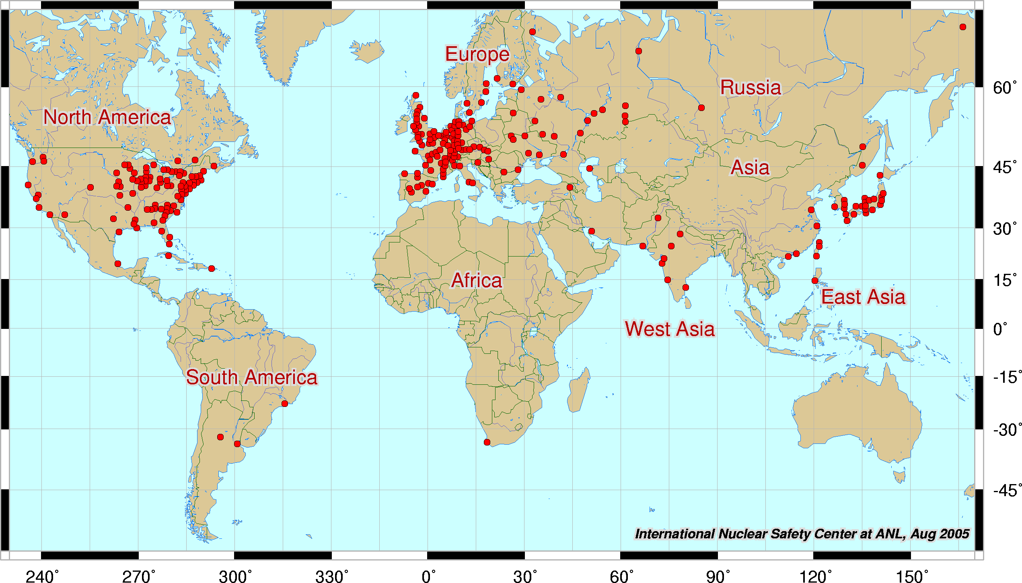
Risk Spectrum PSA code
Licensed at 50% NPPs over the world
AEP has a license to use code (unlimited in time)
Code has been certified by the Russian Regulatory Body
19
19
Notes:
19
В основе информационной модели АЭС лежит комплексная модель энергоблока в формате 3D, включающая в себя информацию по всем дисциплинам проекта. В качестве информационной среды разработки 3D-модели выбрана базовая интеграционная платформа SmartPlant Enterprise.
19

Slide 20
Illustration of fault tree in PSA software representation

Slide 21
Probability
Probability is a numerical measure of the likelihood that an event will occur (e.g. failure occur with a certain probability)
Probability values are always assigned on a scale from 0 to 1
The probability represent varying degrees of likelihood that an event will occur
A probability near 0 indicates that the event is unlikely to occur
A probability near 1 indicates that an event is almost certain to occur

Slide 22
Requirements to risk assessment: SF-1
Requirements and recommendation related to PSA, whish were included in new safety standards, were adopted based on agreement of all the members of the IAEA
Safety Fundamentals SF-1:
Principle 5: “Optimization of protection” underlines necessity assessment and control of risks :
“3.22. To determine whether radiation risks are as low as reasonably achievable, all such risks, whether arising from normal operations or from abnormal or accident conditions, must be assessed (using a graded approach) a priori and periodically reassessed throughout the lifetime of facilities and activities. ”
The tool of risk assessment is Probabilistic Safety Assessment (PSA)

Slide 23
NPP probabilistic safety analysis
PSA is a systematic analysis of interaction NPP systems and staff to assess the degree of NPP safety level
PSA usually focuses on events, which may lea to core damage and radioactive release outside the containement
  Potentially high hazard for population
  Other radioactive sources (spent fuel) are also investigated
PSA is aimed at maximum realistic and complete to use
  Information about NPP design features
  Operating experience
  Component reliability data
  Data on human reliability
  Knowledge about accident development before and after core damage
  Potential ecological consequences and impact on population health

Slide 24
Advantages of using probabilistic methods
Risk for complecated technical systems is impossible to calculate only based on statistical data
Knowledge gained in risk analysis can be used for:
  Eliminating design deficiencies
  Finding additional ways for enhancing NPP safety
  Creating balance design from safety point of view
  Improving NPP operating modes and maintenance
  Training operators
  Determinating factors dominant for frequency and consequences of accidents
  Defining the areas of research

Slide 25
Location of spent fuel
Container
Reactor
SF pool

Slide 26
Illustration of PSA Scope
RISK = FREQUENCY & CONSEQUENCES
For NPPs, the risk from all radioactivity sources at the site needs to be assessed, however the focus is on the reactor core as the major source
Level-1 PSA for internal IEs for at-power operation
Z
INITIATING EVENTS AND HAZARDS
Y
External hazards (natural and human-
induced)
Other internal hazards
Internal fires and floods
Internal initiating events (caused by random component failures and human errors)
OPERATING MODES
Shutdown state
Low power
Nominal power
1
2
3
X
PSA LEVELS
(characterize the extent of accident scenario development)
.
Level-1: Core damage frequency
Level-2: Release categories and their frequencies
Level-3: Individual risk of death for a member of the public, early and late health effects, societal effects
Notes:
26
Generally, risk is the frequency of undesirable consequences.
The scope of risk assessment for nuclear power plants can be considered as three-dimensional. This diagram illustrates the overall possible scope of PSA.
First of all, on X axis, depending on the consideration of the extent of accident scenario development, Level-1, Level-2, and Level-3 PSA are distinguished:
Level 1 PSA is focused on identification of fault sequences of components and/or human errors leading to core damage and calculates the core damage frequency.
Level 2 PSA further analyses the progression of accident scenarios, identifies the ways in which radioactive releases can occur, and defines the composition, timing, quantity, and associated frequencies of the radioactive releases.
Level 3 PSA is focused on the analysis of off-site consequences and calculates individual risk of death for a member of the public, early and late health effects, and other societal effects, such as contamination of land and food
Next, on Y axis we have different operational modes. The analysis can be conducted for full power operating conditions as well as for low power and shutdown modes of the plant.
On Z axis we have different initiating events and hazards that should be considered; these include internal initiating events caused by random component failures and human errors, internal hazards such as fires and floods initiated from the sources inside the plant, and external hazards, both natural and man-induced, such as earthquake and airplane crash. Combined hazards are also considered.
Typically, a PSA study starts from the Level-1 PSA for internal initiating events for full power operating conditions (the blue element) – this is usually the basis for the rest of the PSA. After this is done, usually other hazards are included in the analysis (the yellow element), and then other operational modes are analyzed (along the Y axis). The vertical cross-section at point ‘1’ on the X axis gives a picture of a full-scope Level-1 PSA. The same can be considered for Level-2 and Level-3 PSA.
A full-scope risk assessment for NPPs includes all elements depicted in the diagram. Level-1, Level-2, and Level-3 PSAs are sequential analyses, where the results of the previous level serves as an input for the next level.

Slide 27
Full scope PSA levels 1 and 2
PSA-1 for internal initiating events
PSA level 1 model
for Novovoronezh-2
PSA-1 for internal hazards (fires, floods)
PSA-1 for external hazards,
e.g. seismic PSA
PSA level 2 model
for Novovoronezh-2
Full-scope PSA level 1
Core damage risk
PSA level 2
Information to support decision making for plant design optimization
Risk profile:
Main contributors
Uncertainty
Sensitivity
Radioactive release risk

Slide 28
PSA Level 1
Definition of Plant Operating States
Initiating Event
Analysis
Accident Sequences
Development
System analysis
and Fault Trees
Development
Data
Preparation
and Analysis
Plant Model
Integration
Human
Reliability
Analysis
DOMINANT ACCIDENT SEQUENCES
DOMINANT MINIMAL CUT SETS
ESTIMATION OF CORE DAMAGE FREQUENCY
INSIGHTS

Slide 29
Integrated PSA Model

Slide 30
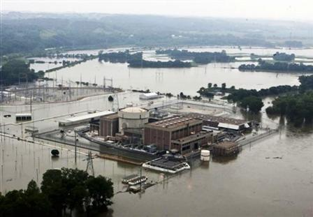
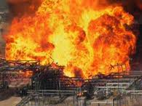
PSA Level 1 results
OPB-88/97 -1E-5/a
INSAG-12 IAEA – 1E-5/a
30
30

Slide 31
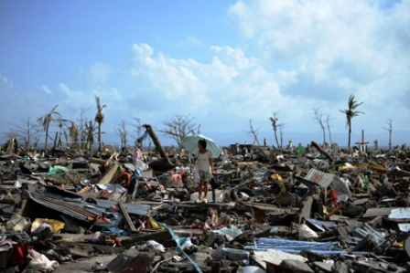
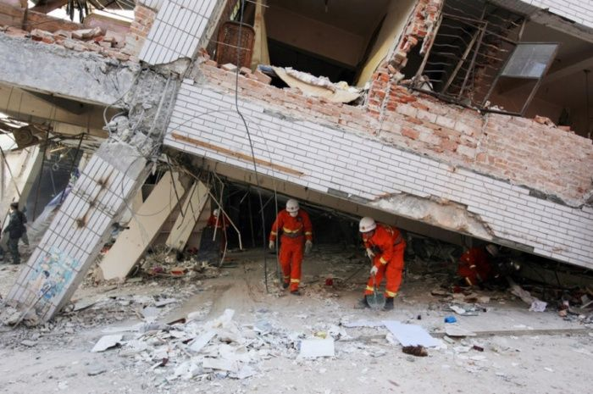
Contribution of external hazards to CDF
The use of a passive heat removal system (PHRS) to the ultimate heat sink, as well as physical and spatial separation of the safety system trains show efficient performance under the conditions created by internal or external hazards

Slide 32
Level 2 PSA

Slide 33
PSA Level 2 results
OPB-88/97 – 1E-7/a
INSAG-12 IAEA – 1E-6/a

Slide 34
Main references for PSA Level 1
Procedures for Conducting Probabilistic Safety Assessments of Nuclear Power Plants (Level 1); IAEA Safety Series No. 50-P-4; IAEA; July 1992
Development and Application of Level 1 Probabilistic Safety Assessment for Nuclear Power Plants; IAEA Specific Safety Guide No. SSG-3; IAEA; April 2010
PRA Procedures Guide - A Guide to the Performance of Probabilistic Risk Assessments for Nuclear Power Plants; NUREG/CR-2300; NRC; January 1983

Slide 35
IAEA SPECIFIC SAFETY GUIDES ON PROBABILISTIC SAFETY ASSESSMENT (PSA)
Published in 2010

Slide 36
Russian Regulatory documents
OPB-88/97: Safety Goals in terms of core damage and large release probabilities (CDF=1E-5/a; LRF=1E-7/a)
Licensing Administrative Regulations: PSA-1 and PSA-2 are necessary for both construction and operation licences
NP-095-15: PSA-1 and PSA-2 are required
RB-024-11: detailed recommendations to format and content of PSA-1 by the end of plant construction process
RB-044-09: detailed recommendations to format and content of PSA-2 by the end of plant construction process
RB-076-12: the same for fire and flood PSAs
RB-021-14: the same for external events PSA
RB-123-17: the same for seismic hazard PSA
RB-100-15: detailed recommendations to reliability analysis of safety related systems and their funstions
Russian regulation is in line with IAEA documents

Slide 37
Summary
This presentation introduced basic concepts, considerations and elements used in the probabilistic safety assessment
  Risk
  Probability
  Event and fault tress
More detailed discussions will follow

Slide 38
The end
Thank you very much for your attention!
Questions?
☺

